Slide 1
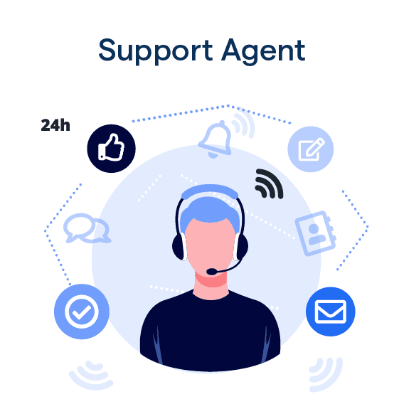
IT Support Team Performance - Data Analysis & Recommendations
Excel-Based Dashboard & Insights
Presented By – Mousumi Gorai
Date – 01 June 2025

Slide 2

Agenda
Introduction
Data Overview
Objectives of Analysis
Key Questions & Insights
Analytical Approaches
Key Findings
Recommendations

Slide 3

Introduction
In today’s fast-paced IT landscape, reliable and efficient support is vital to business continuity and user Satisfaction. This project analyzes internal IT ticket data to evaluate agent performance, workload distribution, and key drivers of resolution time and Satisfaction.
The analysis supports strategic decisions across three investment areas:
Hiring additional agents
Providing targeted training
Upgrading support tools and systems
. By leveraging data insights, the goal is to enhance support efficiency, reduce delays, and improve overall service quality.

Slide 4
Data Overview
Dataset Description : This dataset contains records of IT support tickets used to analyze agent performance and support effectiveness. It captures essential details from ticket generation to resolution, covering various aspects like priority, severity, and customer satisfaction.
Key Information in the Dataset :
Ticket ID – Unique identifier for each support ticket
Agent Details – ID, name, and age of the support agent
Ticket Priority & Severity – Indicates urgency and impact level of the issue
Request Category & Issue Type – Describes the nature of the support request
Ticket Created Time – When the ticket was raised
Resolution Time – Time taken to resolve each ticket
Satisfaction Rate – Customer satisfaction based on ticket handling

Slide 5

Objectives of Analysis
Identify patterns impacting resolution speed and satisfaction Rate
Track performance changes over time
Identify areas for improvement
Enhance decision-making regarding staff and tools

Slide 6
Count of Tickets by Request Category
Insights :
System-related tickets dominate at 40% (39,002), followed by Login Access issues at 30% (29,193).
Software requests contribute to 20% (19,570) of the tickets.
Hardware-related requests are the least frequent, making up only 10% (9,733).
Recommendations :
Automation and standard responses needed to handle high volume.
Improve guides/training to reduce repeat queries.
Shift resources toward system and login support for better efficiency .

Slide 7
Issue Type by Ticket Count
Insights :
IT Requests account for the majority of tickets at 75% (73,220 out of 97,498).
IT Errors represent 25% of total tickets (24,278), indicating a notable volume of recurring system issues .
High volume of IT Requests suggests ongoing demand for system access, configuration, or general support.
Recommendation:
Automate frequent IT Requests through self-service tools or knowledge base .
Investigate root causes of IT Errors to reduce repeat incidents .
Allocate more staff or resources toward handling IT Requests efficiently due to their volume.

Slide 8
Priority by Ticket Count
Insights :
High priority tickets are the most common (35,549).
Unassigned priority tickets are also high (29,410).
Low and Mid priorities are relatively fewer.
Recommendations :
Review unassigned tickets to avoid delays.
Audit priority tagging for consistency .
Balance workloads based on priority levels.
Priority by Ticket Count

Slide 9
Count of Tickets by Severity and Priority
Insights :
Most tickets are marked as Normal severity across all priority levels.
Very few tickets fall under Major, Minor, Urgent, or Unclassified categories .
Unassigned priority exists across all severities, especially in Normal.
Recommendations :
Review and optimize ticket triaging process to reduce overuse of "Normal" severity .
Encourage agents to classify tickets accurately by severity and priority to reflect true urgency and impact .
Investigate high volume of unassigned priorities in Normal severity to improve response time and accountability.

Slide 10
Average Resolution Time and Satisfaction Rate by Request Category
Insights:
🖥️ Hardware/System - Slow resolution, Low satisfaction
💾 Software - Moderate delay, Average satisfaction
🔐 Login Access - Fast resolution, High satisfaction
Recommendation :
. Invest in better technology/tools
. Focus on improving hardware/system ticket handling
. Enhance agent efficiency for complex issues.
. Aim to boost employee satisfaction in underperforming categories.

Slide 11
Ticket Volume, Avg Resolution Time & Satisfaction by Age Group
Insights :
Agents 40–44 handled the most tickets but had highest resolution time.
Lowest satisfaction seen in agents aged 35–39.
Younger agents (20–29) performed well overall.
Recommendations :
Provide targeted training or workflow support to agents aged 35–44 to boost efficiency and satisfaction.
Balance ticket load across age groups.
Encourage knowledge sharing from high-performing younger agents.

Slide 12
Monthly Trends: Ticket Volume, Resolution Time & Satisfaction
Insights :
Highest ticket volume occurred in August .
Resolution time peaked in July (4.62 days), while satisfaction dipped slightly .
Despite volume changes, satisfaction and resolution times stayed mostly stable.
Recommendations :
Monitor resolution times during peak months.
Boost support in Q3–Q4.
Investigate other satisfaction factors.
Use Jan as a process benchmark.

Slide 13
Top 5 Agents by Satisfaction Score
Insights :
Diana Rojo leads with the highest satisfaction rate (4.60).
All top 5 agents have scores above 4.45, indicating consistently excellent service.
Performance gap is minimal, showing strong overall agent quality.
Recommendation :
Recognize and reward top performers to maintain motivation.
Encourage peer learning by having top agents share best practices.
Monitor consistency to ensure satisfaction remains high across the team.

Slide 14
Ticket Trend Over Time (2016–2020)
Insights :
Steady ticket volume growth observed over five years .
Notable increase begins in early 2019, continuing through 2020.
Volume more than doubled compared to early 2016 levels.
Recommendations :
Scale support resources to match rising demand .
Analyze 2019–2020 spikes to identify root causes (e.g., tech changes, org growth).
Consider automation or self-service tools to manage future volume efficiently.

Slide 15
Key Findings
Top agents (e.g., Diana Rojo) deliver both high satisfaction and quick resolutions.
High ticket volume does not equal high performance — skill matters more.
Hardware requests have the longest resolution time due to physical dependencies.
Resolution time spiked in June, indicating tool or resource strain under pressure.
Agent performance is steady overall — no immediate firing needed.
Current tools are adequate, but not optimized for high-demand periods.
Training and workflow optimization offer the best short-term return on investment.

Slide 16
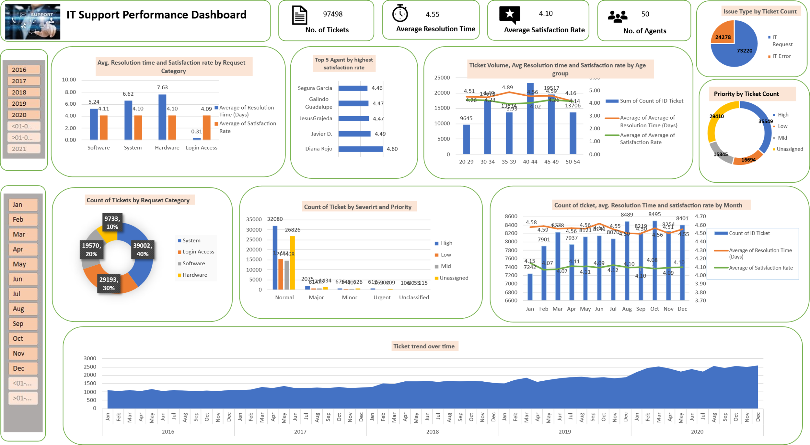

Slide 17
Overall Recommendations
Short-Term Recommendations :
🧠 Train existing agents with high resolution times or low satisfaction
🔄 Standardize workflows for handling hardware requests
📊 Monitor performance regularly and provide feedback
⚖️ Balance ticket load to avoid agent overload
Long-Term Recommendations:
💻 Upgrade software/tools to improve efficiency during peak periods
🔧 Improve inventory & procurement processes for hardware supports
✅ Focus on high-ROI improvements like training & optimization

Slide 18

Conclusion
This analysis demonstrates the power of data in driving smarter IT support strategies . By identifying key performance gaps and strengths, we can enhance service quality, optimize resources, and make informed, high-impact decisions.

Slide 19

Thank You

